Slide 1

Game Theory II
HE3001, Microeconomics 3 Nanyang Technological University

Slide 2

Mixed Strategies (Recap)
From last week’s lecture…
A mixed strategy for player $i$ is a probability distribution $σ_{i}∈ΔS_{i}$. Where for any action in their action set, $a^{j}∈S_{i}, { σ}_{i}\left(a^{j}\right)∈\left[0,1\right]$ denotes the probability of player $i$ choosing $a^{j}$in the mixed strategy $σ_{i}$.
(!!) From now on, the term “strategies” will be used to refer to mixed strategies which are more general.

Slide 3
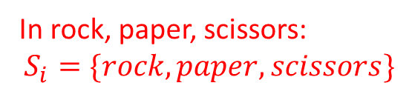
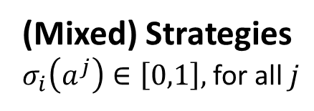
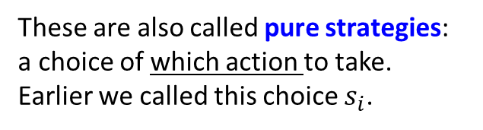
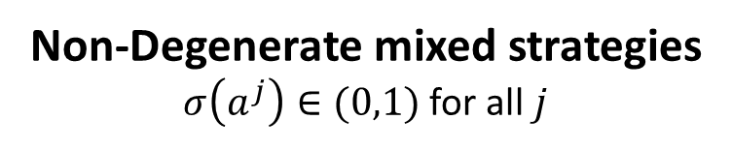
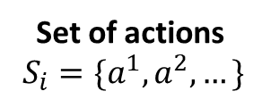
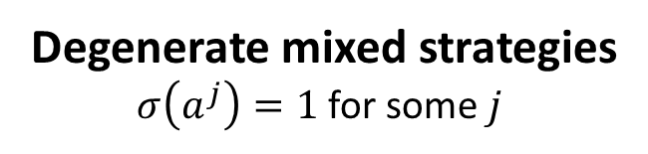
A taxonomy of strategies.
Set of actions
$S_{i}=\{a^{1},a^{2},…\}$
In rock, paper, scissors:
$$S_{i}=\{rock, paper, scissors\}$$
(Mixed) Strategies
$σ_{i}\left(a^{j}\right)∈\left[0,1\right],$for all $j$
Degenerate mixed strategies
$σ\left(a^{j}\right)=1$ for some $j$
Non-Degenerate mixed strategies
$σ\left(a^{j}\right)∈(0,1)$ for all $j$
These are also called pure strategies: a choice of which action to take.
Earlier we called this choice $s_{i}$.
These are a choice of how to randomise between actions.
E.g. Play rock.
E.g. Play rock with probability ½ and scissors with probability ½ .

Slide 4
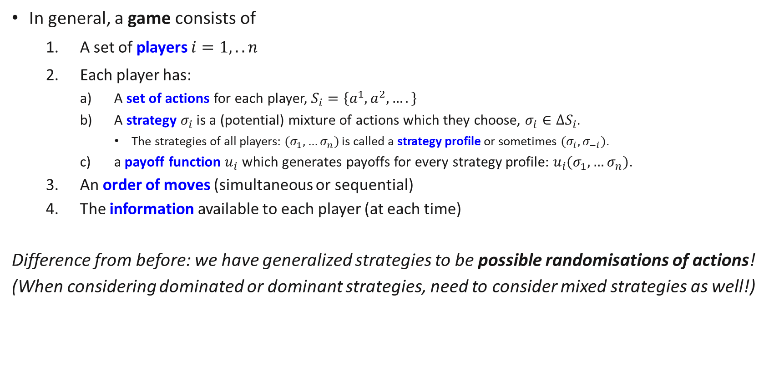
Parameters of a Game (Updated)
In general, a game consists of
A set of players $i=1,..n$
Each player has:
A set of actions for each player, $S_{i}=\left\{a^{1},a^{2},….\right\}$
A strategy $σ_{i}$ is a (potential) mixture of actions which they choose, $σ_{i}∈ΔS_{i}$.
The strategies of all players: $(σ_{1},…σ_{n})$ is called a strategy profile or sometimes $(σ_{i},σ_{−i})$.
a payoff function $u_{i}$ which generates payoffs for every strategy profile: $u_{i}(σ_{1},…σ_{n})$.
An order of moves (simultaneous or sequential)
The information available to each player (at each time)
Difference from before: we have generalized strategies to be possible randomisations of actions!
(When considering dominated or dominant strategies, need to consider mixed strategies as well!)
Notes:
Note: the actions which they can choose are just pure strategies.

Slide 5

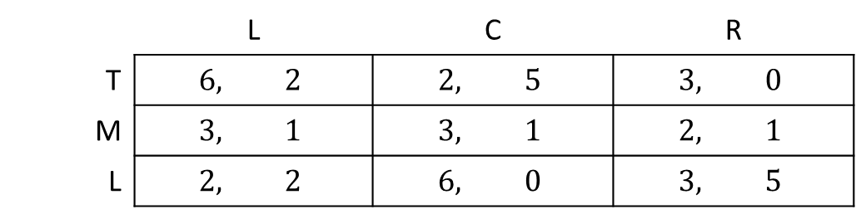
Review Questions 1
Consider the game below.
Which of Player 1’s strategies (if any) is strictly dominated? – M , 0.5T 0.5 L
Which of Player 2’s strategies (if any) is strictly dominated? - None
Remember to consider the mixed strategies!
Player 2
Scan here
to participate!
 | L | C | R
T | $$6, 2$$ | $$2, 5$$ | $$3, 0$$
M | $$3, 1$$ | $$3, 1$$ | $$2, 1$$
L | $$2, 2$$ | $$6, 0$$ | $$3, 5$$
Player 1
Notes:
In general, a strategy which is strictly a best response to some action will never be strictly dominated.

Slide 6
Mixed Nash Equilibria

Slide 7
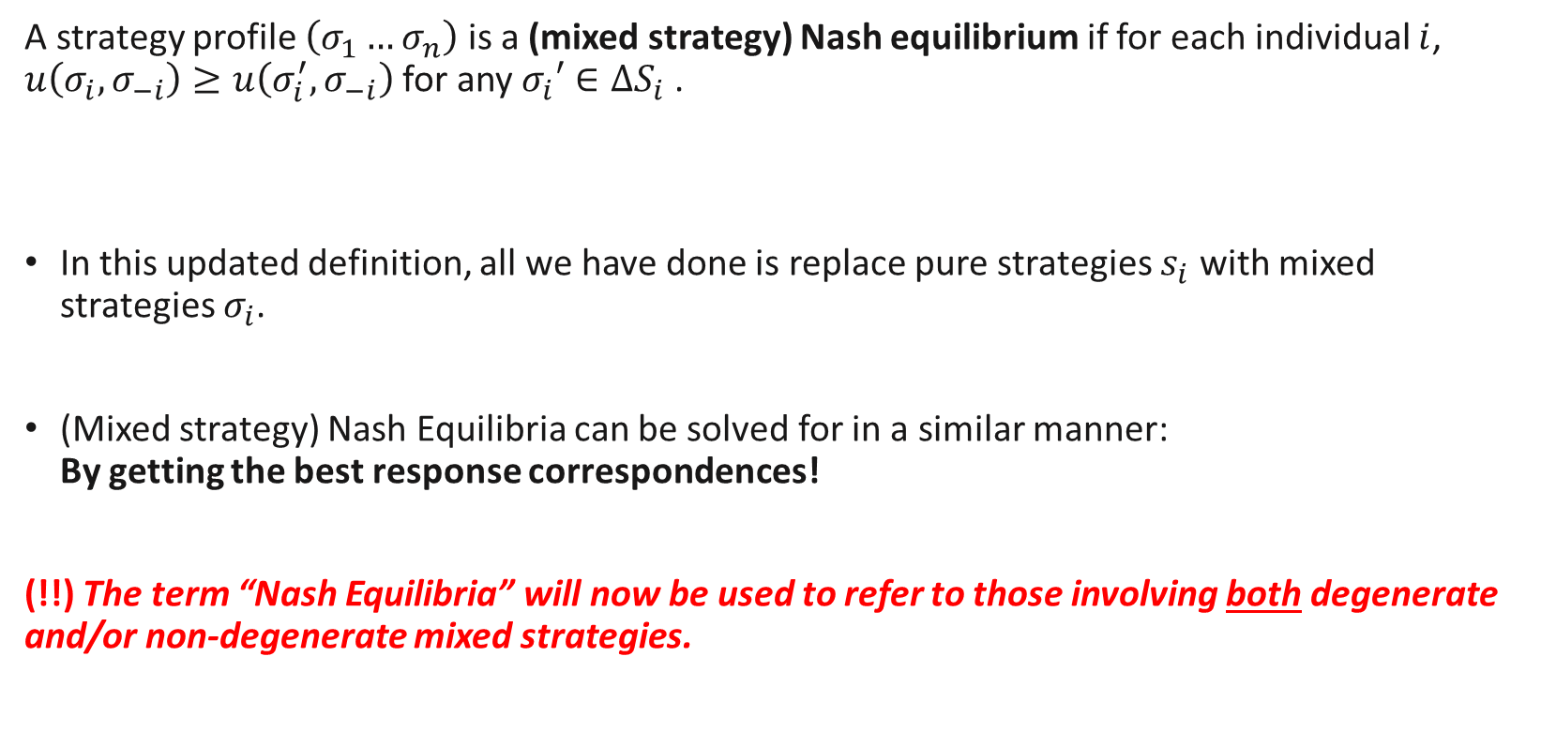
Mixed Strategy Nash Equilibrium
A strategy profile $\left(σ_{1}…σ_{n}\right)$ is a (mixed strategy) Nash equilibrium if for each individual $i$, $u\left(σ_{i},σ_{−i}\right)≥u\left(σ_{i}^{′},σ_{−i}\right)$for any $σ_{i}′∈{ΔS}_{i}$.
In this updated definition, all we have done is replace pure strategies $s_{i}$ with mixed strategies $σ_{i}$.
(Mixed strategy) Nash Equilibria can be solved for in a similar manner: By getting the best response correspondences!
(!!) The term “Nash Equilibria” will now be used to refer to those involving both degenerate and/or non-degenerate mixed strategies.
Notes:
When you are asked to look for Nash Equilibria, you will have to look for both pure strategy Nash equilibria and (non-degenerate) mixed strategy Nash equilibria.

Slide 8
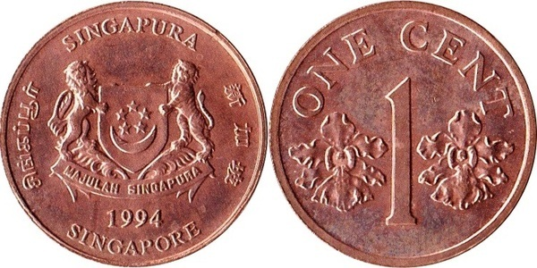
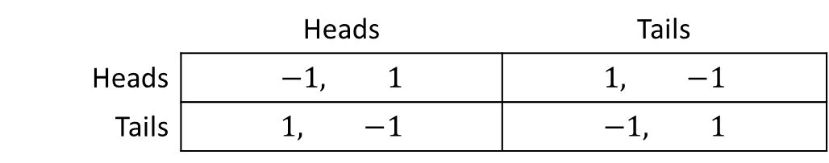
Matching Pennies Again
Player 2
 | Heads | Tails
Heads | $$−1, 1$$ | $$1, −1$$
Tails | $$1, −1$$ | $$−1, 1$$
Player 1
Allowing for mixed strategies, there is a NE in the matching pennies game.
Non-degenerate mixed strategy NE where each of Player 1 and 2 chooses Heads and Tails with probability ½.

Slide 9
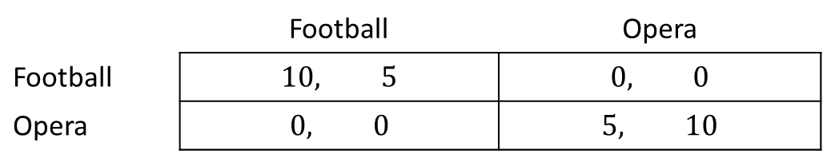
Solving for all NE
Now, we will see how to solve for all NE in two player games with two actions.
We assume that players maximise expected payoffs/utility.
Consider the following battle of sexes game:
Wife
 | Football | Opera
Football | $$10, 5$$ | $$0, 0$$
Opera | $$0, 0$$ | $$5, 10$$
Husband

Slide 10

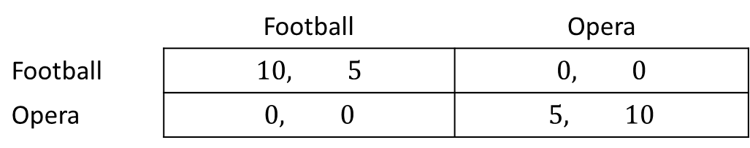



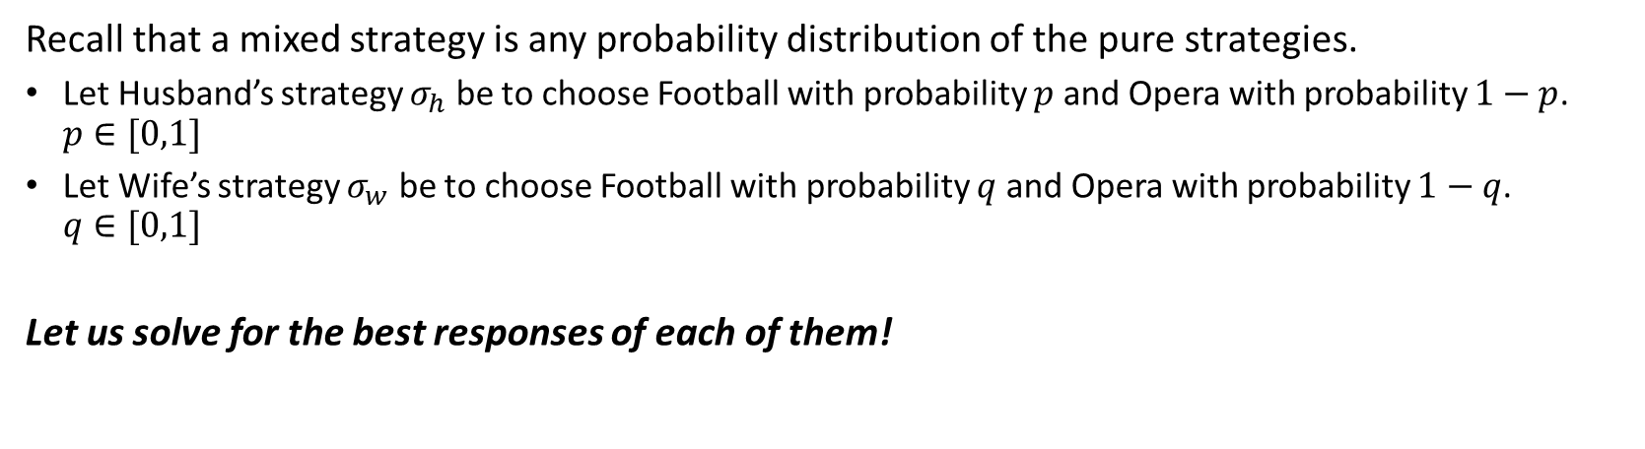
Solving for all NE
Wife
$$q$$
$$1−q$$
 | Football | Opera
Football | $$10, 5$$ | $$0, 0$$
Opera | $$0, 0$$ | $$5, 10$$
$$p$$
Husband
$$1−p$$
Recall that a mixed strategy is any probability distribution of the pure strategies.
Let Husband’s strategy $σ_{h}$ be to choose Football with probability $p$ and Opera with probability $1−p$. $p∈[0,1]$
Let Wife’s strategy $σ_{w}$ be to choose Football with probability $q$ and Opera with probability $1−q$. $q∈[0,1]$
Let us solve for the best responses of each of them!

Slide 11
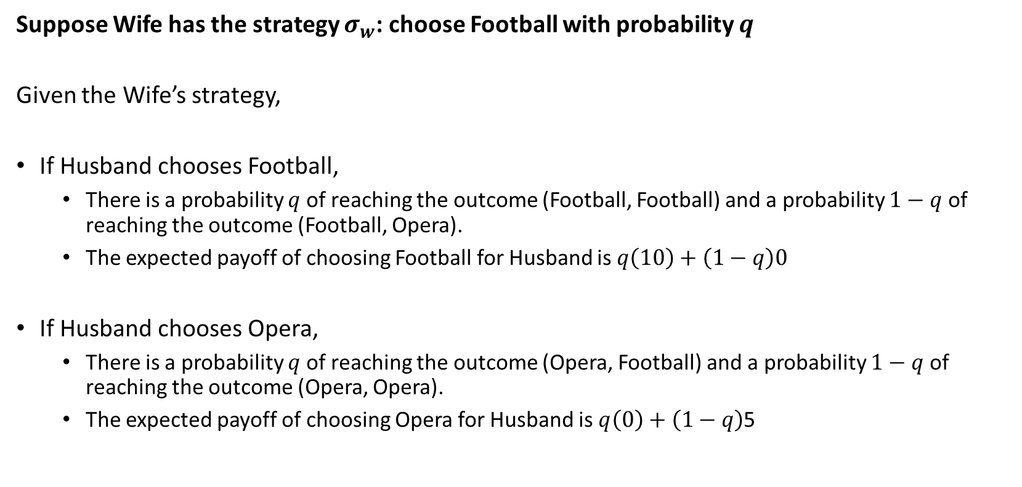
Solving for all NE (Husband’s BR)
Suppose Wife has the strategy $σ_{w}$: choose Football with probability $q$
Given the Wife’s strategy,
If Husband chooses Football,
There is a probability $q$ of reaching the outcome (Football, Football) and a probability $1−q$ of reaching the outcome (Football, Opera).
The expected payoff of choosing Football for Husband is $q\left(10\right)+\left(1−q\right)0$
If Husband chooses Opera,
There is a probability $q$ of reaching the outcome (Opera, Football) and a probability $1−q$ of reaching the outcome (Opera, Opera).
The expected payoff of choosing Opera for Husband is $q\left(0\right)+\left(1−q\right)$5
Notes:
Here we are considering whether F (p=1) or O (p=0) will be a best response for the husband.
Why do we not need to consider whether a mixed strategy 0<p<1 will the best response?
This is because the expected payoffs of such a strategy will always lie between the payoffs of the pure strategies (F, O)
Payoff (p) = p Payoff(F,q) + (1-p) Payoff(O,q).

Slide 12
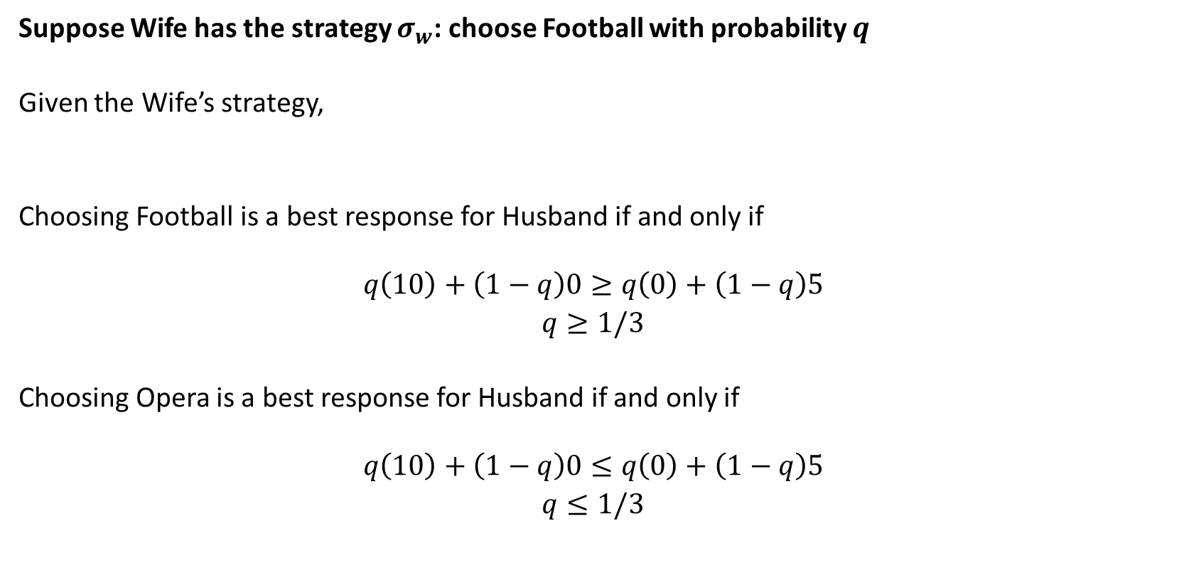
Solving for all NE (Husband’s BR)
Suppose Wife has the strategy $σ_{w}$: choose Football with probability $q$
Given the Wife’s strategy,
Choosing Football is a best response for Husband if and only if
$$q\left(10\right)+\left(1−q\right)0≥q\left(0\right)+\left(1−q\right)5$$
$q≥1/3$
Choosing Opera is a best response for Husband if and only if
$$q\left(10\right)+\left(1−q\right)0≤q\left(0\right)+\left(1−q\right)5$$
$q≤1/3$
Notes:
Here we are considering whether F (p=1) or O (p=0) will be a best response for the husband.
Why do we not need to consider whether a mixed strategy 0<p<1 will the best response?
This is because the expected payoffs of such a strategy will always lie between the payoffs of the pure strategies (F, O)
Payoff (p) = p Payoff(F,q) + (1-p) Payoff(O,q).

Slide 13
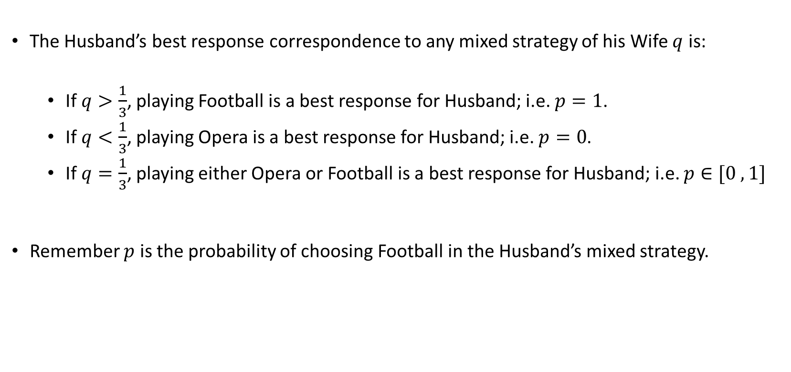
Solving for all NE (Husband’s BR)
The Husband’s best response correspondence to any mixed strategy of his Wife $q$ is:
If $q>\frac{1}{3}$, playing Football is a best response for Husband; i.e. $p=1$.
If $q<\frac{1}{3}$, playing Opera is a best response for Husband; i.e. $p=0$.
If $q=\frac{1}{3}$, playing either Opera or Football is a best response for Husband; i.e. $p∈[0 , 1]$
Remember $p$ is the probability of choosing Football in the Husband’s mixed strategy.

Slide 14
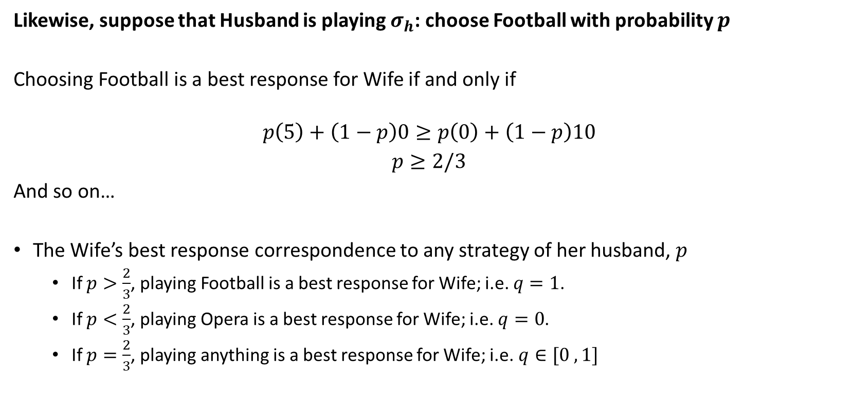
Solving for all NE (Wife’s BR)
Likewise, suppose that Husband is playing $σ_{h}$: choose Football with probability $p$
Choosing Football is a best response for Wife if and only if
$$p\left(5\right)+\left(1−p\right)0≥p\left(0\right)+\left(1−p\right)10$$
$p≥2/3$
And so on…
The Wife’s best response correspondence to any strategy of her husband, $p$
If $p>\frac{2}{3}$, playing Football is a best response for Wife; i.e. $q=1$.
If $p<\frac{2}{3}$, playing Opera is a best response for Wife; i.e. $q=0$.
If $p=\frac{2}{3}$, playing anything is a best response for Wife; i.e.$q∈[0 , 1]$

Slide 15
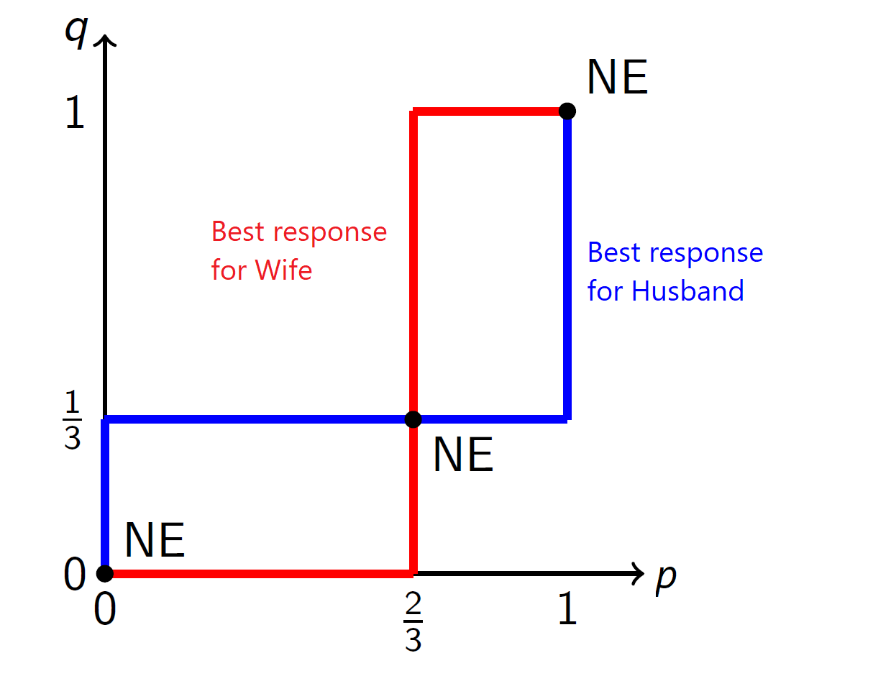
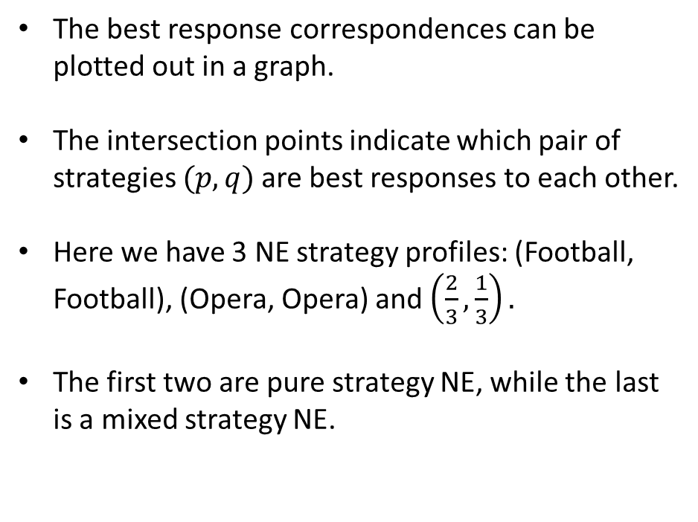
Solving for all NE
The best response correspondences can be plotted out in a graph.
The intersection points indicate which pair of strategies $(p,q)$are best responses to each other.
Here we have 3 NE strategy profiles: (Football, Football), (Opera, Opera) and $\left(\frac{2}{3},\frac{1}{3}\right).$
The first two are pure strategy NE, while the last is a mixed strategy NE.

Slide 16
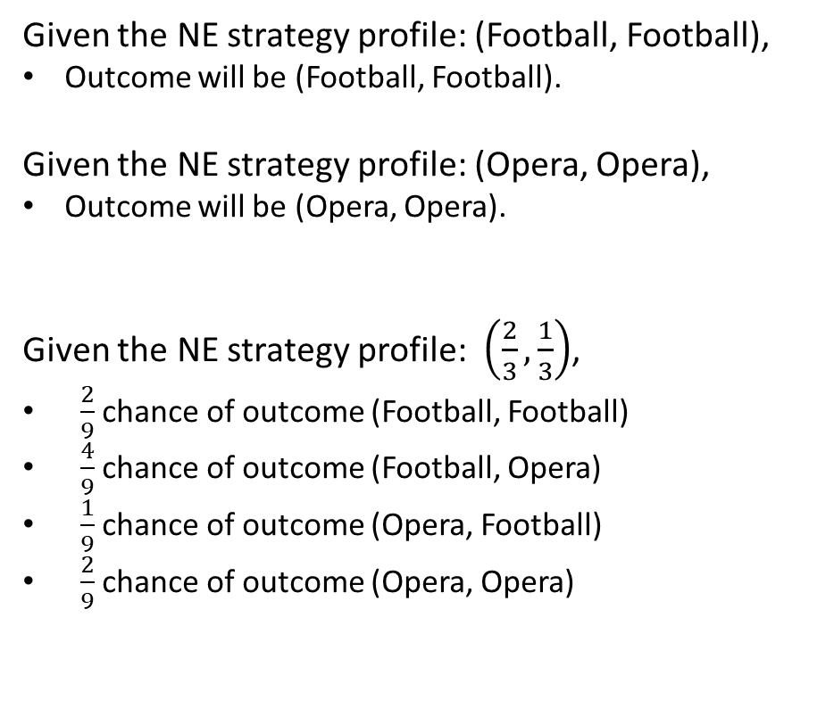
NE outcomes
Given the NE strategy profile: (Football, Football),
Outcome will be (Football, Football).
Given the NE strategy profile: (Opera, Opera),
Outcome will be (Opera, Opera).
Given the NE strategy profile: $\left(\frac{2}{3},\frac{1}{3}\right)$,
$\frac{2}{9}$ chance of outcome (Football, Football)
$\frac{4}{9}$ chance of outcome (Football, Opera)
$\frac{1}{9}$ chance of outcome (Opera, Football)
$\frac{2}{9}$ chance of outcome (Opera, Opera)

Slide 17
Applications
Notes:
Now that we have learned how to solve for general Nash equilibria in static games of complete information, which is the most widely used solution concept, we can now looks at some applications of these.

Slide 18
Classes of Games.
There are two interesting classes of games applied to the study of many topics.
Games of Coordination
Payoff to players are highest if they can coordinate the sets of actions which they take. E.g. Battle of sexes game.
Games of Competition
Gains for one player mean losses for another and players will never agree on the sets of actions which they should take. Usually involve only mixed strategy Nash equilibria.
Here we discuss examples of each.

Slide 19
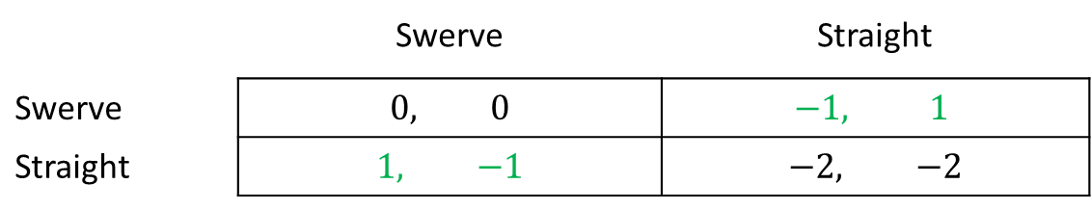
Games of Coordination : Chicken game
An example of a game of coordination is the Chicken game where there are two “Utilitarian” Nash equilibria (Straight, Swerve) and (Swerve, Straight).
Notice that there is no Pareto Ranking between the two.
Even if they can agree that a utilitarian outcome is better, how will it be chosen?
Player 2
 | Swerve | Straight
Swerve | $$0, 0$$ | $$−1, 1$$
Straight | $$1, −1$$ | $$−2, −2$$
Player 1
Notes:
(Note that they chicken out by swerving to a safe direction, we assume they won’t collide then!)
For example, if Player 1 is male, and Player 2 is female.
Norms of males being courageous may lead to beliefs which lead to the Straight Swerve equilibria.

Slide 20
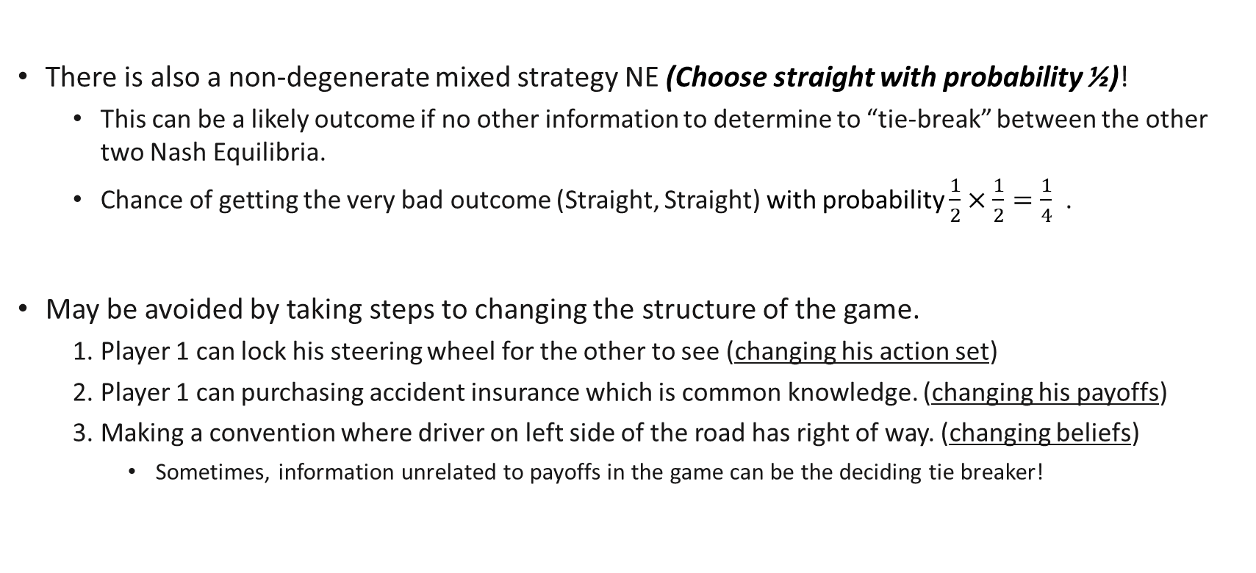
Games of Coordination: Chicken game
There is also a non-degenerate mixed strategy NE (Choose straight with probability ½)!
This can be a likely outcome if no other information to determine to “tie-break” between the other two Nash Equilibria.
Chance of getting the very bad outcome (Straight, Straight) with probability $\frac{1}{2}×\frac{1}{2}=\frac{1}{4}$ .
May be avoided by taking steps to changing the structure of the game.
Player 1 can lock his steering wheel for the other to see (changing his action set)
Player 1 can purchasing accident insurance which is common knowledge. (changing his payoffs)
Making a convention where driver on left side of the road has right of way. (changing beliefs)
Sometimes, information unrelated to payoffs in the game can be the deciding tie breaker!

Slide 21
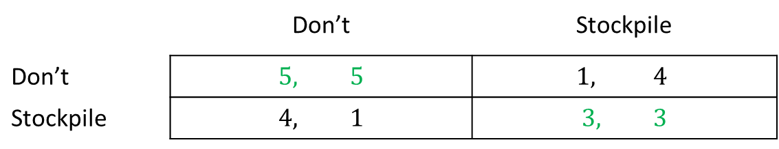
Games of Coordination : Assurance Games
An assurance game is a simultaneous game with multiple Nash equilibria, one of which pareto dominates the others. An example is the arm’s race problem.
3 NE: (Don’t, Don’t), (Stockpile, Stockpile) , (Stockpile with probability 2/3, Stockpile with probability 2/3).
(Don’t, Don’t) pareto improves on all other NE (and outcomes), and is pareto efficient, but is not the unique NE!
If it were possible for Russia to assure US that it will not stockpile, then can get to that equilibria.
E.g. Russia moves first and opens itself to inspection --- more on sequential games later!
Russia
 | Don’t | Stockpile
Don’t | $$5, 5$$ | $$1, 4$$
Stockpile | $$4, 1$$ | $$3, 3$$
US
Notes:
If there is strong reason to believe the other is stockpiling, then they will end up in the pareto dominated equilibria.

Slide 22
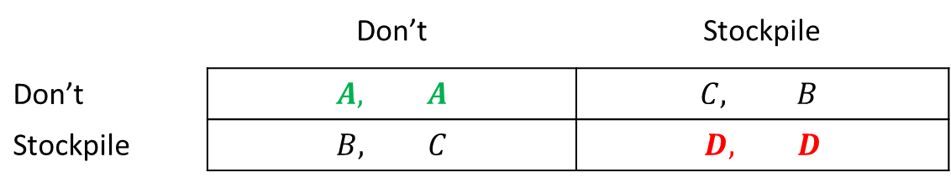
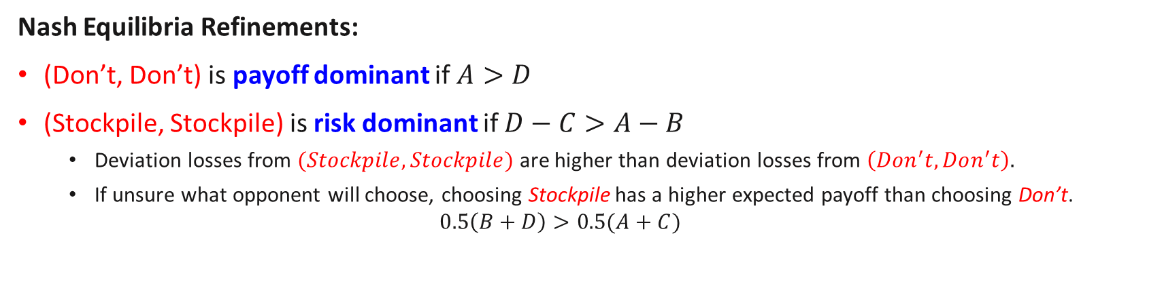


Payoff dominance and risk dominance
In assurance games, a pareto efficient NE may not always be the likely outcome!
Russia
 | Don’t | Stockpile
Don’t | $$A, A$$ | $$C, B$$
Stockpile | $$B, C$$ | $$D, D$$
$$A>B$$
US
$$D>C$$
Nash Equilibria Refinements:
(Don’t, Don’t) is payoff dominant if $A>D$
(Stockpile, Stockpile) is risk dominant if $D−C>A−B$
Deviation losses from $(Stockpile,Stockpile)$ are higher than deviation losses from $\left(Don^{′}t,Don^{′}t\right).$
If unsure what opponent will choose, choosing Stockpile has a higher expected payoff than choosing Don’t. $0.5\left(B+D\right)>0.5(A+C)$
and vice versa..
Notes:
If A=10, D=5, C=4, B=3, then D,D is payoff dominant and S,S is not risk dominant.
If A=5, D=10, C=4, B=1, then D,D is not payoff dominant, but S,S is risk dominant.

Slide 23
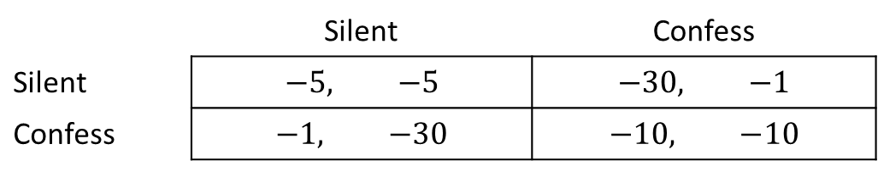
Games of Coordination: Prisoner’s Dilemma
A prisoner’s dilemma game reflects a scenario where each player has a dominant strategy which leads to failure to coordinate on the efficient outcome.
Confess is a dominant strategy here for each, so the unique NE outcome is (Confess, Confess).
This outcome is pareto improved on by (Silent, Silent): it is “inefficient”!
Moving sequentially will not solve this problem… But, if we expand the game and play it repeatedly, then possible to have some punishment which enforces cooperation. More on repeated games later!
Clyde
 | Silent | Confess
Silent | $$−5, −5$$ | $$−30, −1$$
Confess | $$−1, −30$$ | $$−10, −10$$
Bonnie
Notes:
Depending on the definition of coordination, might not be strictly classified as coordination.
Usually, Coordination Games will have multiple pure strategy NE like in the previous two games and need some way of coordinating on the “right” one.
In the PD game, the “right” outcome is not a NE though..

Slide 24
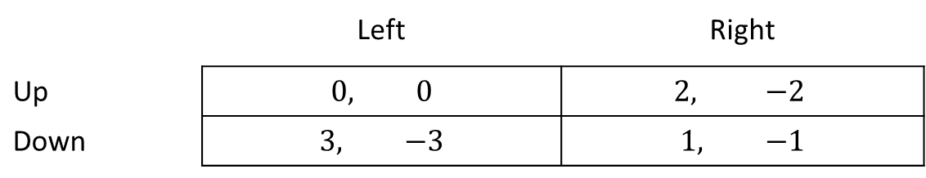
Games of Competition: Constant Sum Games
A constant sum game is a simultaneous play game where an increase in payoff to one player is associated with an exact decrease in payoff to the other player.
Related to zero sum games. (Sum of entries in each box is always fixed)
In two action games, given the conflicting interests, Nash Equilibria are mostly in mixed strategies. (E.g. when there are no dominant strategies for each player)
Player 2
 | Left | Right
Up | $$0, 0$$ | $$2, −2$$
Down | $$3, −3$$ | $$1, −1$$
Player 1
Notes:
Consider a 2 player game with 2 actions.
Suppose that (X1,Y1) is a pure strategy NE.
Then since Y1 is a best response for player 2, we have u2(X1,Y1)$≥u$2(X1, Y2).
From a constant sum game with a fixed sum of C we have that u1(X1,Y1)= C – u2(X1,Y1)
Since X1 is a best response for player 1, we have u1(X1,Y1)$≥u$1(X2,Y1).
From the constant sum game, this implies that C-u2(X1,Y1)$≥$ C-u2(X2,Y1) or u2(X1,Y1)$≤$ u2(X2,Y1)
Since Player 2 does not have a dominant strategy, we must have u2(X2,Y1)$≤$u2(X2,Y2)
Together this implies that $u$2(X1, Y2)$≤$ u2(X1,Y1) $≤$ u2(X2,Y1) $≤$u2(X2,Y2)
Or $u$2(X1, Y2) $≤$u2(X2,Y2)
But from the constant sum game, this means that C-$u1$(X1, Y2) $≤$ C- u1(X2,Y2)
Or $u1$(X1, Y2) $≥$ u1(X2,Y2)
Together with u1(X1,Y1)$≥u$1(X2,Y1), this implies that Player 1 has a dominant strategy!
Hence, when there are no dominant strategies, there can be no pure strategy NE.
Suppose Y1 is the best response to X1 for Player 2.
Since Player 2 does not have a dominant strategy, this means Y2 is the best response to X2 for Player 2.
This means that u2(X1,Y1)$≥$ u2(X1,Y2) and u2(X2,Y2)$≥$ u2(X2,Y1)
By the constant sum game, this means that u1(X1,Y1)<= u1(X1,Y2) and u1(X2,Y2)$≤$ u1(X2,Y1)
If X1 is also the best response to Y1 for Player 1, then u1(X1,Y1)>= u1(X2,Y1)
Or u2(X1,Y1)<= u2(X2,Y1)
u2(X1,Y1)$≥$ u2(X1,Y2)
Dominant strategy for Player 2 if U2(X1,Y1)>= U2(X1,Y2) and if U2(X2,Y1)>= U2(X2,Y2)

Slide 25
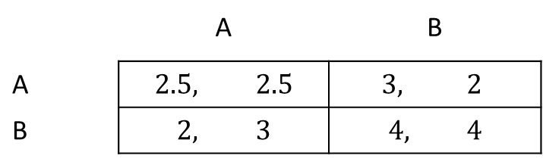
Review Questions 2
1. Consider finite games where a player has a finite number of (pure) strategies and there are finite players. (True or False)
There is always a Nash Equilibrium in pure strategies. F
There is always a Nash Equilibrium in (degenerate OR non-degenerate) mixed strategies. T
2. Select all which apply to the following assurance game.
There is a risk dominant strategy profile. Yes
There is a payoff dominant strategy profile. Yes
The risk dominant strategy profile is the same as the payoff dominant strategy profile. Yes
Player 2
 | A | B
A | $$2.5, 2.5$$ | $$3, 2$$
B | $$2, 3$$ | $$4, 4$$
Player 1

Slide 26
Sequential Games

Slide 27
Sequential Games: who plays when?
So far, we have only analysed games where players moved simultaneously. These are called simultaneous games.
But there are other games where players move one after another. These are called sequential games.
In two-player sequential games, we call the player who moves first the 1st mover and the player who moves second the 2nd mover.

Slide 28
Sequential Games: who observes what?
While the order of movement matters, more importantly is what kind of information is observed.
For example, Player 2 could move after Player 1, but may or may not observe what Player 1 did.
This is important! If Player 2 observes what Player 1 does, he/she can choose a different action depending on Player 1’s action.
In sequential games like Tic-Tac-Toe, Chess where this holds, each player always has a strategy for what to do for each action of their opponent so as to win.
As we will see, this implies that strategies in sequential games can be much more complex!

Slide 29
An example
While the order of movement matters, more importantly is what kind of information is observed.
For example, Player 2 could move after Player 1, but may or may not observe what Player 1 did.
This is important! If Player 2 observes what Player 1 does, he/she can choose a different action depending on Player 1’s action.
In sequential games like Tic-Tac-Toe, Chess where this holds, each player always has a strategy for what to do for each action of their opponent so as to win.
As we will see, this implies that strategies in sequential games can be much more complex!

Slide 30
Sequential Games: who observes what?
A game is said to have perfect information if players move one at a time and the player at each move knows exactly the full history of moves thus far in the game.
Otherwise, a game is said to be of imperfect information.
 | Move Sequentially | Move Simultaneously
Know full history | Perfect Information | -
Do not full history | Imperfect Information | Imperfect Information
Even if players move sequentially, if no observation of others actions, it is as if they are moving simultaneously!

Slide 31
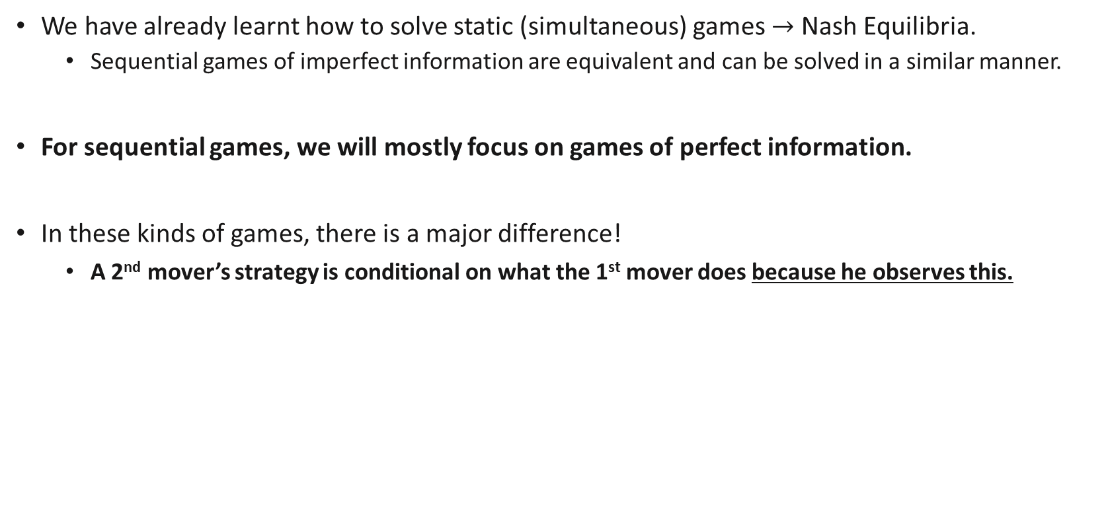
Sequential Games of Perfect Information
We have already learnt how to solve static (simultaneous) games $→$ Nash Equilibria.
Sequential games of imperfect information are equivalent and can be solved in a similar manner.
For sequential games, we will mostly focus on games of perfect information.
In these kinds of games, there is a major difference!
A 2nd mover’s strategy is conditional on what the 1st mover does because he observes this.
Generally, strategies of players must be such that a third party can play on their behalf no matter what happens in the history of the game.

Slide 32



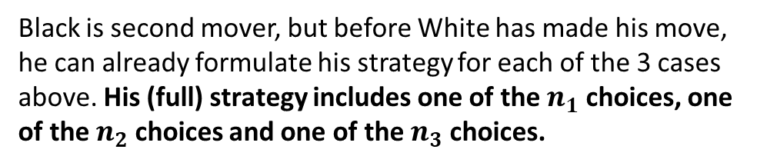



Sequential Games of Perfect Information
Case 1
Case 2
Case 3
2
3
$n_{1}$ choices
$n_{2}$ choices
$n_{3}$ choices
1
Black is second mover, but before White has made his move, he can already formulate his strategy for each of the 3 cases above. His (full) strategy includes one of the $n_{1}$ choices, one of the $n_{2}$ choices and one of the $n_{3}$ choices.
White is first mover and has 3 choices in his action set. His strategy is one of these.
The choice conditional on each case is important as it will determine what is white’s best move!

Slide 33
Extensive Form Representation

Slide 34
Extensive form
In sequential games, the game together with the timings of movement can be represented in a game-tree form or extensive form.
L
3
Decision nodes are labelled as circles here
A player has to make a choice at these nodes.
Player 1 chooses between A and B.
Player 2 observes Player 1’s choice and chooses between U and D.
Player 3 observes Player 1 and 2’s choices and chooses between L and R.
U
R
2
L
A
D
3
R
1
L
U
3
B
R
2
D
L
3
R

Slide 35
Information Sets
What information they possess can also be shown in the extensive form
Information sets (dotted lines) connect decision nodes for which players are unable to distinguish from each other.
Players make a common decision for decision nodes in an information set.
L
3
U
R
Player 1 chooses between A and B.
Player 2 does not observe Player 1’s choice and chooses between U and D.
Player 3 observes Player 1 and 2’s choices and chooses between L and R.
2
L
A
D
3
R
1
L
U
3
B
R
2
D
L
3
R

Slide 36
Information Sets
L
3
Player 1 chooses between A and B.
Player 2 observes Player 1’s choice and chooses between U and D.
Player 3 observes Player 1’s choice but not Player 2’s choice and chooses between L and R.
Here, it is as if Player 2 and Player 3 play a simultaneous move game after 1 makes his decision.
U
R
2
L
A
D
3
R
1
L
U
3
B
R
2
D
L
3
R

Slide 37
Review Questions 3a
L
3
U
Does Player 2 know whether Player 1 Chose A or B? Yes
R
2
L
A
D
3
R
Does Player 3 know whether Player 1 Chose A or B? Yes
1
L
U
3
B
R
Does Player 3 know whether Player 2 Chose U or D? Depends. If player 1 choose A then he don’t know, if player 1 chooses B then he knows
2
L
D
3
R

Slide 38
Review Questions 3b
L
3
U
Fill in the information sets for the below scenario:
Player 1 chooses between A and B.
Player 2 does not observe Player 1’s choice and chooses between U and D.
Player 3 observes Player 2’s choice but not Player 1’s choice and chooses between L and R.
R
2
L
A
D
3
R
1
L
U
3
B
R
2
L
D
3
R

Slide 39
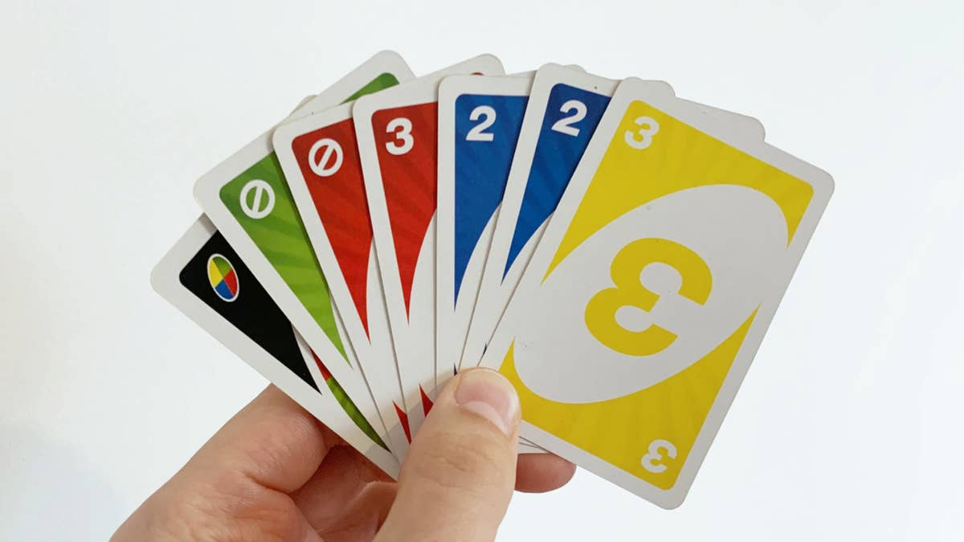
Identifying all strategies
In sequential games, players need to make a decision at all decision nodes in separate information sets.
In games of perfect information, players will have a decision node at each possible history.
Next players strategy:
Which card (combinations) to play if I play:
Yellow 1
Yellow 2
…
Blue 1
Blue 2
…
Red 1
Red 2
…
My strategy:
Which of my card (combinations) to play
Notes:
Before Player 1 takes action, it is as if Player 2 has already though about what he would do for every possibility he observes.
Player 1 thinks about this when making his strategy choice.

Slide 40
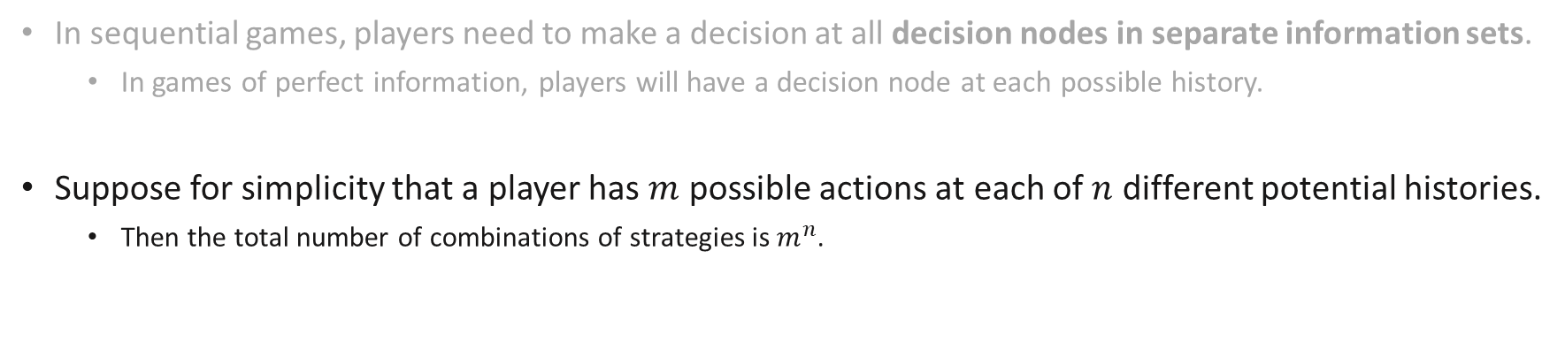
Identifying all strategies
In sequential games, players need to make a decision at all decision nodes in separate information sets.
In games of perfect information, players will have a decision node at each possible history.
Suppose for simplicity that a player has $m$ possible actions at each of $n$ different potential histories.
Then the total number of combinations of strategies is $m^{n}$.
T
M
@ History 1: L Choose between: | @ History 2: R Choose Between:
T | T
M | M
B | B
2
Specifying the strategy chosen for each potential history is important because it affects what the first mover will want to choose!
L
B
1
R
T
M
2
B
Notes:
Before Player 1 takes action, it is as if Player 2 has already though about what he would do for every possibility he observes.
Player 1 thinks about this when making his strategy choice.

Slide 41
Review Questions 4
Consider a game where Player B moves after observing Player A’s move. Player A can choose either L or R while Player B can choose either T, M, or B.
How many pure strategies does Player A have in his strategy set? 2
How many pure strategies does Player B have in his strategy set?

Slide 42
Key Learning Outcomes
Understand what mixed strategies are and how to solve for general Nash Equilibria with mixed strategies.
Understand the different applications of static games.
Understand how sequential games are formulated.
Perfect vs Imperfect information.
Extensive form, information sets…
Identifying all possible strategies.

Slide 43
Readings
Varian Chapter 29
Varian Chapter 30 (optional)
Osborne, An Introduction to Game Theory (optional): A game theory reference textbook
Osborne and Rubinstein, A Course in Game Theory (optional): A game theory reference textbook
https://www.bbc.com/news/science-environment-27228416

